Slide 1

Docker: Build, Ship and Run Any App, Anywhere
Robert Schultz Technical Director @ Ancestry.com
Notes:
----- Meeting Notes (7/27/14 19:47) -----
I'm going to talk about something different today. But it's something that affects how we build and deploy applications as developers.

Slide 2
What is Docker?
“Docker is an open-source project to easily create lightweight, portable, self-sufficient containers from any application. The same container that a developer builds and tests on a laptop can run at scale, in production, on VMs, bare metal, OpenStack clusters, public clouds and more.”
- Solomon Hykes, Docker’s Founder & CTO
Notes:
----- Meeting Notes (7/27/14 19:47) -----
This is something we've been waiting a long time for. As anyone knows, the tedious task of building something and having to configure it on different environments and machines is a pain. We tend to offload this task to others but realistically you build the application and should thus understand how it reaches productio n.

Slide 3
Quick Introduction
Been with Ancestry in San Francisco for about 3.5 years
Building web applications for 13 years
Part of the original core Merlin, Interactive Image and Find A Grave teams
Working with mobile teams as Technical Director
Focusing on more emerging and open source platforms recently such as node.js, angular, go, docker
I really love building web applications and advocating for the open web!

Slide 4
Stack Delivery Today
Disperse configuration of stacks across developers, environments, etc.
“Works on my machine” syndrome
We have solved this partially with Vagrant (you are using Vagrant, right?)
But it stops at the developers local environment
Dedicated VM resources are required for every environment
Provisioning is extremely slow, upwards of 15 minutes to get live
Notes:
----- Meeting Notes (7/27/14 20:21) -----
Where are we at today with building our apps?

Slide 5
Stack Delivery Today Scenario
SASS
Celery
MySql
Nginx
Memcached
Node.js
Flask
Database
Proxy
Redis
Frontend
Python
Cache
API
My
Development
Your
Development
Acceptance
Pre-production
Production

Slide 6
Docker
Provides an easy way to build and package your applications for delivery
Uses a git-like mechanism to commit changes and versioning which creates layers within an image
Ability to push your images to a Docker registry
Operating system is shared amongst all containers via libcontainer
Application centric; build for deployment of apps not operating system
Re-use of containers for other images (e.g. continuous delivery)
Tools to provision and automate your container through API

Slide 7
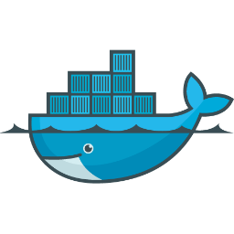
Docker Stack Delivery
SASS
Celery
MySql
Nginx
Redis
Node.js
Flask
Database
Proxy
Redis
Frontend
Python
Cache
API
My
Development
Your
Development
Acceptance
Pre-production
Production

Slide 8
Hypervisor vs. Docker
App A
App B
Virtual Machines
App A
App B
Docker
Libs
Libs
Each virtualized application includes not only the application - which may be only 10s of MB - and the necessary binaries and libraries, but also an entire guest operating system - which may weigh 10s of GB.
The Docker Engine container comprises just the application and its dependencies. It runs as an isolated process in userspace on the host operating system, sharing the kernel with other containers. Thus, it enjoys the resource isolation and allocation benefits of VMs but is much more portable and efficient.
Guest OS
Guest OS
Libs
Libs
Hypervisor
Docker Engine
Host OS
Host OS
Server
Server

Slide 9
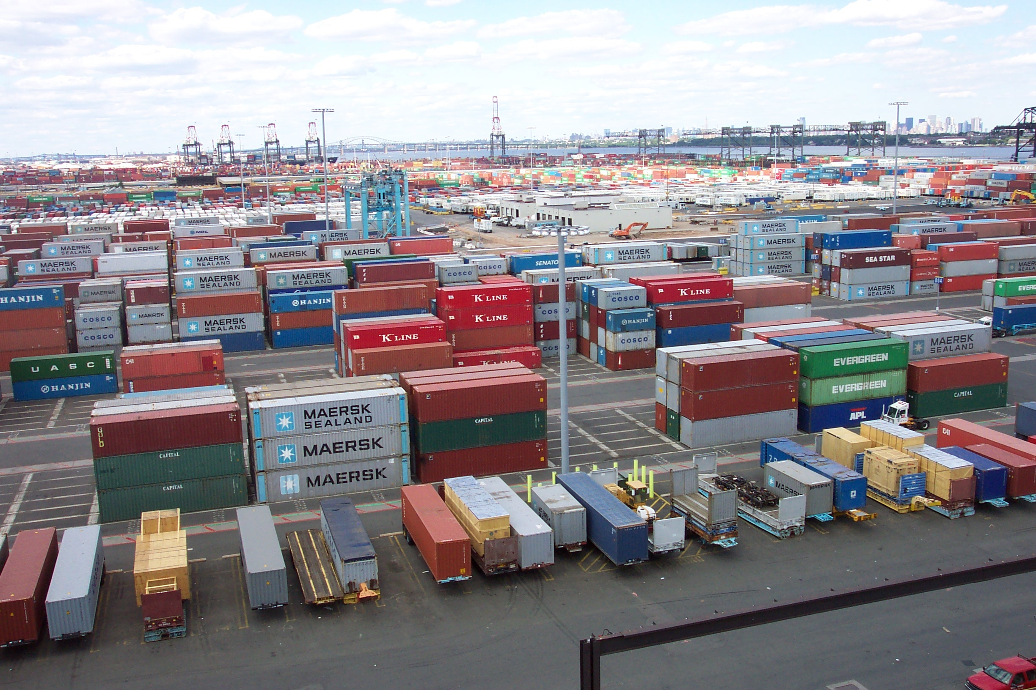
Dockerfile
Build the image for your next generation stack

Slide 10
Dockerfile is your builder
Automate the steps of how you configure and build up each image
Provides a suite of commands to configure what you need
Set working paths, run custom commands, expose ports between the container and the host, run new

Slide 11
Example Dockerfile
FROM node MAINTAINER Robert Schultz rschultz@ancestry.com ADD . /usr/src/app WORKDIR /usr/src/app RUN npm install -g express-generator RUN express -H -f -c less RUN npm install EXPOSE 3000 CMD [ "bin/www" ]

Slide 12
Demo
Notes:
----- Meeting Notes (7/27/14 20:41) -----
Only create the image, not container and demo express app. Wait for that.

Slide 13
Containers
Super charge your VM with isolated user space instances

Slide 14
What is a container?
Think of it like a big shipping container ☺
Virtualization method where the kernel of the operating system allows for multiple isolated user space instances instead of just one
Share host resources such as CPU, memory and disk
They look, feel and act like a real server
Extremely flexible as the containers can share the same kernels, but have isolated process, file system and network interfaces
Spun up via images which are configured via a Dockerfile file

Slide 15
Demo
Notes:
----- Meeting Notes (7/27/14 20:41) -----
Show how to now spin up the container and run the sample express apps.

Slide 16
Docker Registry
Deploy your really awesome Docker images

Slide 17
Docker Registry
Online repository of official pre-build images
Community also provides custom built images for specific purposes
For example, Ruby + Rails + MySQL clients
Unlimited pushing of public images; 1 free private image
http://hub.docker.com
Notes:
----- Meeting Notes (7/27/14 20:44) -----
Fine and dandy, but won't scale for us.

Slide 18
Open Source Docker Registry
Yes, this is also open source!
You can host your own private Docker registry
Provide all of the official supported pre-built kernels and distributions
Build stack images from the official images
Push your built images after continuous integration to the registry to deploy the containers to your hosts
https://github.com/docker/docker-registry

Slide 19
Benchmarks

Slide 20
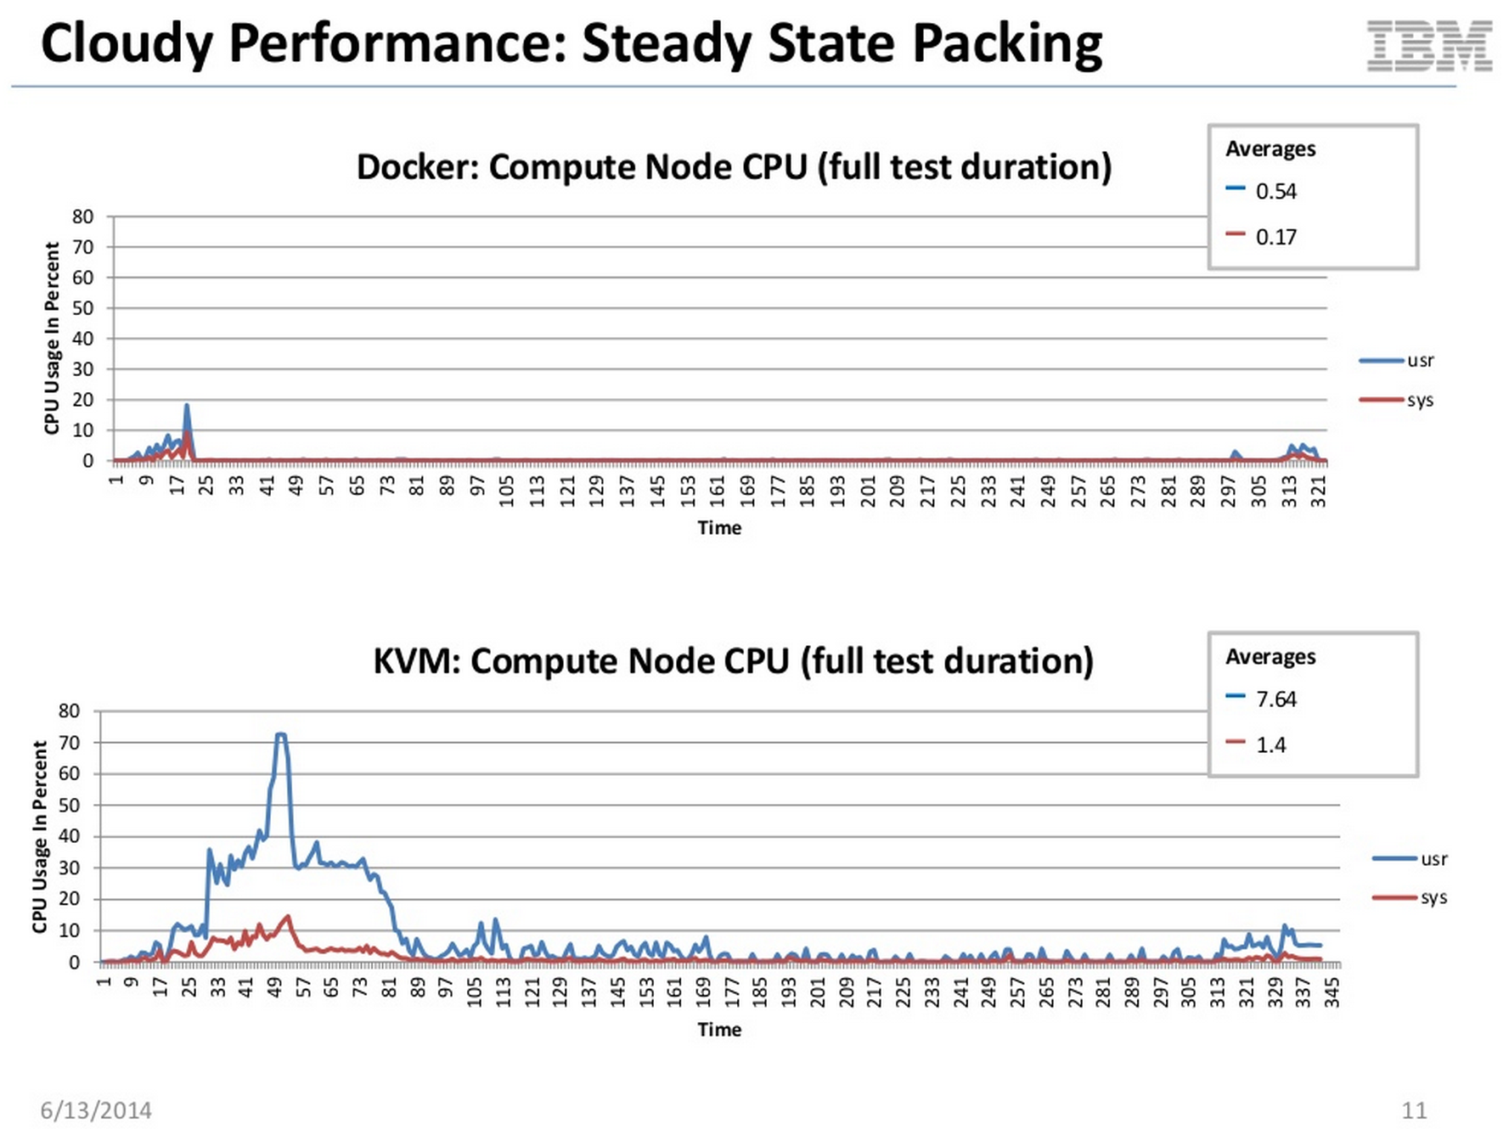

Slide 21
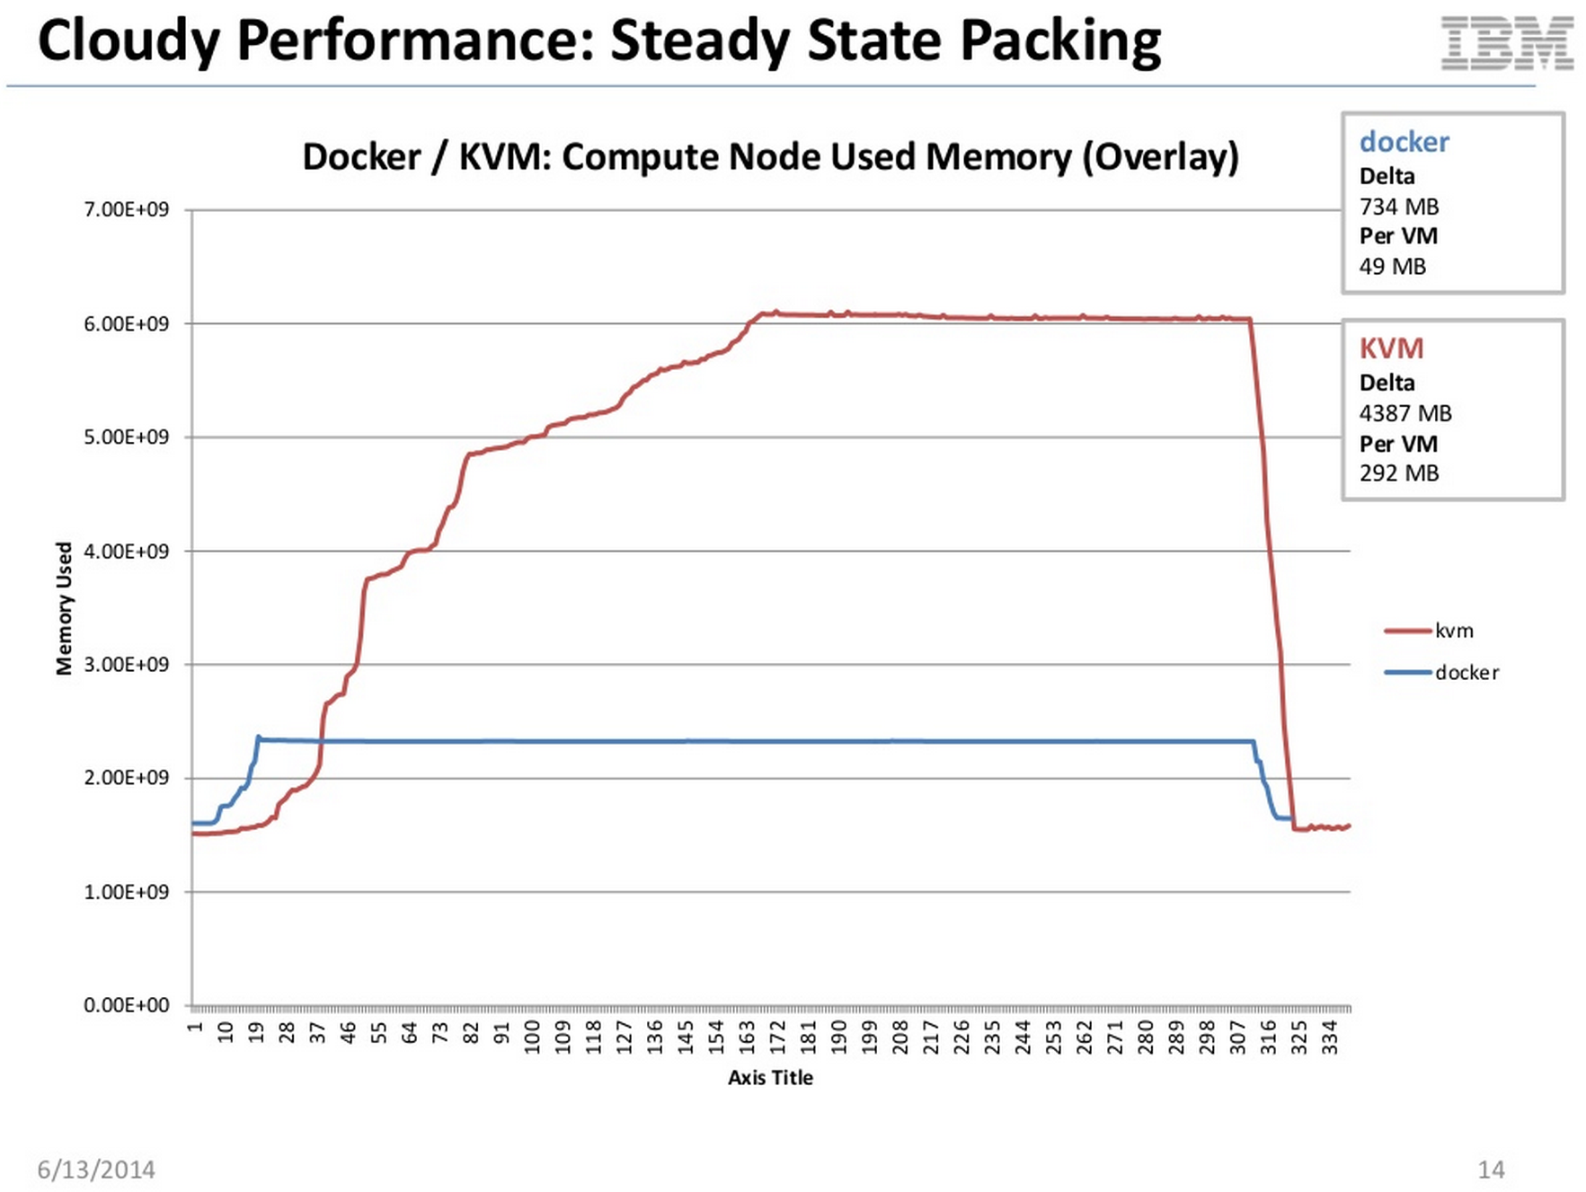

Slide 22
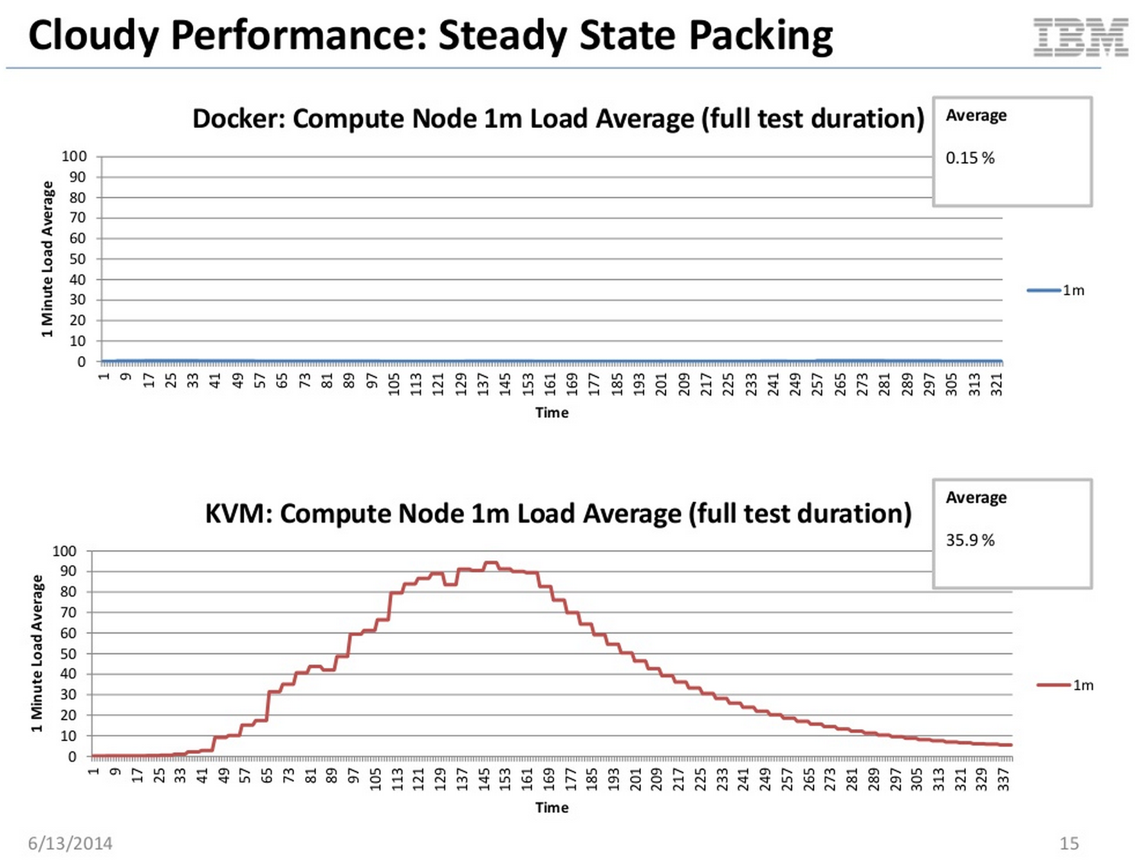

Slide 23
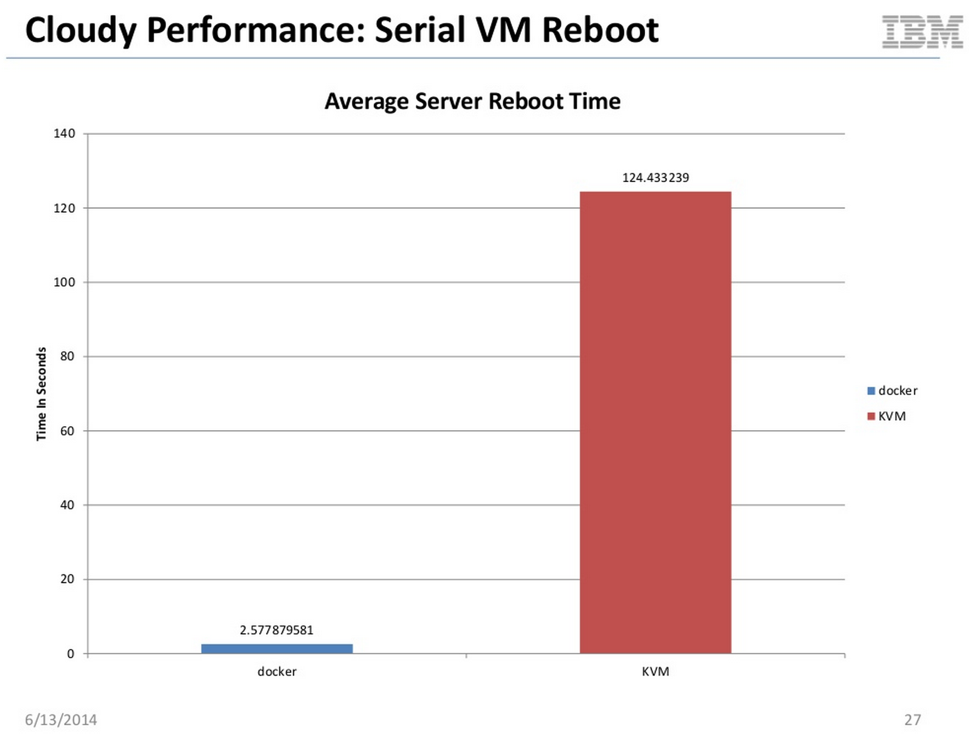

Slide 24
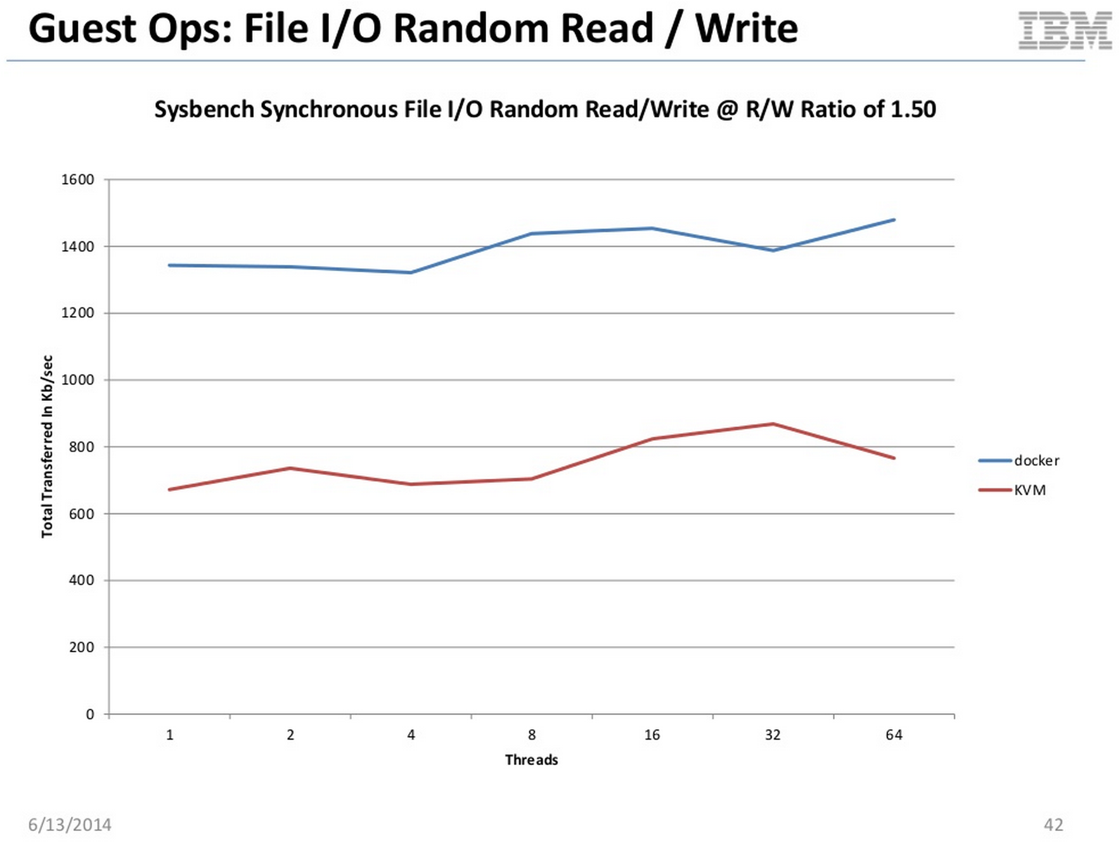

Slide 25
Benchmark Results
IBM study done June, 2014
Docker vs. KVM running on OpenStack infrastructure
Conclusion is that Docker is damn fast!
Pretty much on par with bare metal performance of servers, beats out typical VM scenarios

Slide 26
Use Cases
Super charge your VM with isolated user space instances

Slide 27
Continuous Integration & Delivery
Using Continuous Integration platform such as Jenkins or Go to launch containers straight from publishing to registry
No need to use chef to re-provision a VM every single time; Docker can launch a new container with the new version in a matter of seconds
You can even have Docker running on your agents with no need to have dedicated ACC boxes that suck up needed resources
Keeps the same stack from local machine, acceptance, pre-production to production

Slide 28
Testing
Start up multiple containers efficiently to test your application
Since load time to spin up and configure a VM is quite costly, sometimes in the time of minutes, Docker greatly reduces this overhead

Slide 29
Deployment Efficiency
Since you do not require use of full resources for every single VM instance on each host, you can launch many more containers on the same box
Quicker deployment times from check-in to production
Quicker rollback times
Give more control back to the developers, promote autonomy
DevOps focus more on putting the platform in place, providing the tools, creating base images, injecting cross cutting needs, etc.

Slide 30
Moving to the Cloud
Major cost efficiency since we would not need full time compute instances if they are not being used; same host runs multiple containers
Plays well with OpenStack (in premise, hybrid, cloud)
Integration with things like AWS, Google Compute, Digital Ocean, many others already supported
AWS already has the ability to launch Elastic Beanstalk apps from Docker
More coming

Slide 31



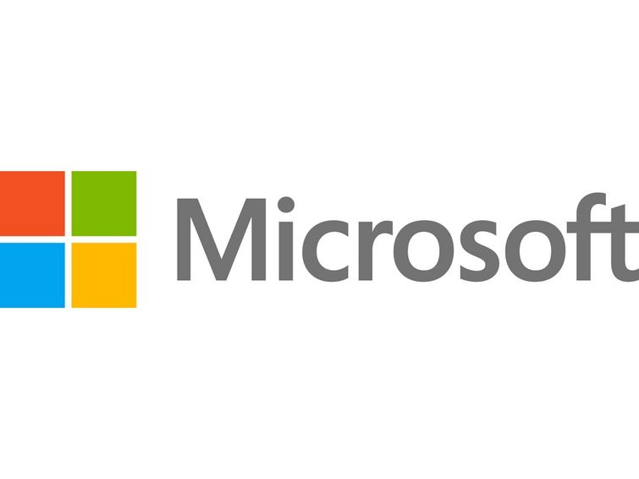



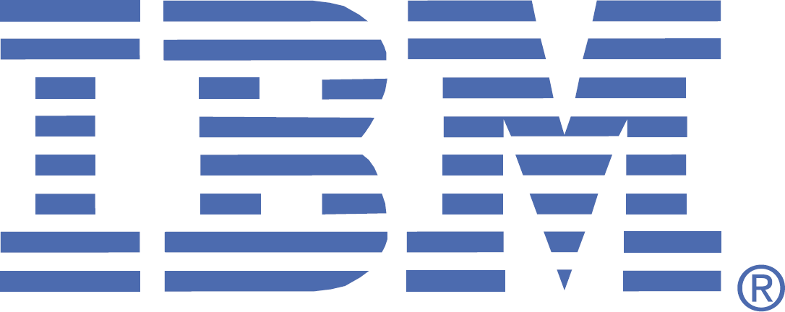


Who is investing into Docker?
?

Slide 32
Thank you
Twitter & GitHub: robertschultz :-)

